Slide 1
Service Orders
How-to Cheat Sheet

Slide 2
Driving Service Opportunities
Create
Salesforce opportunity
Coordinate
Tech meetings
Close
Rough Order of Magnitude
Paperwork (MSA, NDA, Orasi letterhead or customer’s format)
Statement of Work
Signature

Slide 3
Service Order Intake Quickflow
MSA? NDA? SOW on Orasi paper?
Sales
Organization
Create Salesforce Opportunity
Coordinate Tech Calls
Determine
Scope and Rates
Signature
Services
Organization
Contact Sales
Scope
ROM
SOW
Delivery Operations
MSA\SOW Legal Review
Service Ordered
Salesforce Action
Create Opportunity
Set Services LoB as
Needs LoB
Set Status as
Pending Scoping
Set Status as
SOW Creation
Signed, Undelivered

Slide 4
Service Order Intake SAT Team Overlay
MSA? NDA? SOW on Orasi paper?
Sales
Organization
Create Salesforce Opportunity
Coordinate Tech Calls
Determine
Scope and Rates
Signature
Services
Organization
Contact Sales
Scope
ROM
SOW
Delivery Operations
MSA\SOW Legal Review
Service Ordered
Salesforce Action
Create Opportunity
Set Services LoB as
Needs LoB
Set Status as
Pending Scoping
Set Status as
SOW Creation
Signed, Undelivered

Slide 5
Service Order Progression
Create Salesforce Opportunity
Engage with Services Organization
Scope
Summarize service opportunity
Indicate service Line of Business or select “Needs Line of Business”
Select Services Analyst or Needs Services Analyst
Define service need
Strategize
Coordinate
Define need
Match need to services
Generate Rough Order of Magnitude
Tech calls with customer
Finalize
Use ROM to negotiate final scope and rates
Services Analyst to generate SOW
Process Service Order
Attach fully executed SOW to Salesforce opportunity
Procure discount approval, if necessary
Ensure SOW aligns with opportunity
Roles
Rates
Deliverables
“Send to Services Order Review”, button
Attach fully executed SOW
Send
Services rep contacts sales team
Set Status to “Pending Scoping”
Set Status to “SOW Creation”
Set Status to “Signed, Undelivered”

Slide 6
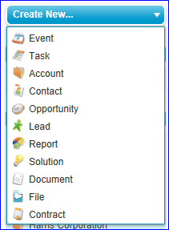
Create a New Opportunity
Salesforce Homepage

Slide 7
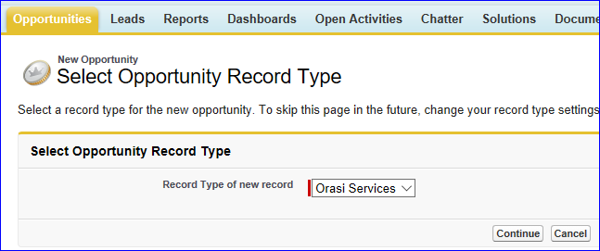

Opportunity Type
Orasi Services

Slide 8
Line of Business Heads & Guidelines
Strategic Atlanta
Bill Hayden
Ann Pierce
Accounts regionally central to Atlanta
Advanced Testing Services
David Guimbellot
Advanced Performance Monitoring
Performance Testing Services
Mobile – performance testing
Brian Crout
Quality Management Services
SAP
Mobile – functional testing
ALM / UFT
Onsite & Mobile Test Automation
Test Management
Rural
Mobile – functional testing
Virginia Vestal
Training
Data Analytics & Visualization
David Hand
Don McElwee
Hosting
OARS
Business Intelligence
Test Data Management
Continuous Delivery
Functional Testing
Performance Testing
Performance Assessments
Performance Mentoring
Security
Dennis Hurst
Saltworks
Z-Other
N/A
Sub-contract work

Slide 9
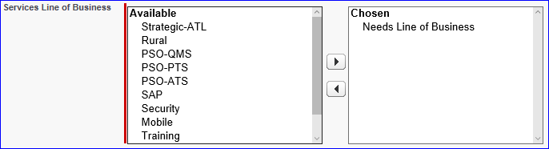
Need Help Determining the Line of Business?
If you aren’t sure, select “Needs Line of Business”.
This triggers an alert for someone from services delivery to contact the
Outside Sales Rep
Our goal is to respond to you before the close of business that day!

Slide 10
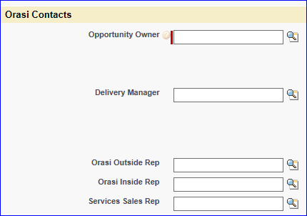

Orasi Contacts Section
Enter if known.

Slide 11
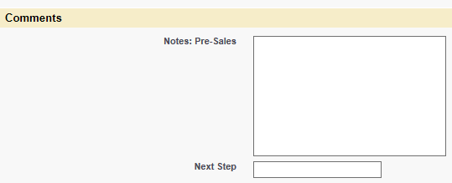
Comments Section
Note any general information pertaining to the service need.
Bob Jones runs a functional testing team that needs support during heavy release cycles.

Slide 12
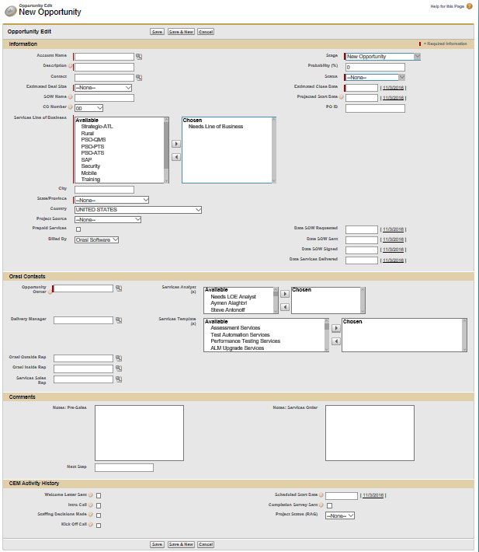
Save

Slide 13
Agreement Review, Execution and Retention
The Orasi legal team can be reached at eContracts@Orasi.com, for review and execution of:
Master Service Agreements
Insurance Certificates (COI)
Non-Disclosure Agreements
Security Questionnaires
Agreements on Orasi letterhead, but with substantial redlines
https://ezone.orasi.com/operations/OpsTeam/SitePages/Home.aspx
MSA’s are stored on eZone here: https://ezone.orasi.com/Contracts/Shared%20Documents/Customer%20Contracts
MSA’s are also stored in the account homepage in Salesforce.

Slide 14
Discount Approvals – Prerequisite to Presenting SOW to Customer
Up to 15%
Account Manager
16 – 25%
1 Sr. Vice-president
More than 25%
1 Sr. Vice-president: Sales
1 Sr. Vice-president: Delivery
*Automated process in Salesforce, triggered by entering role and rate.

Slide 15
Information Required to Generate an SOW
Customer Details
Account Billing Address
Contact (manager or above)
Title
Phone
Email
Services Address
Delivery Details
Business objective and success criteria
Scope – hours, milestones
Deliverables
Orasi Resources
Deal Details
Payment Schedule (fixed bid)
Account Name
Services Description
Rates (hourly)
Travel Policy

Slide 16
Signature Exception Policy – leveraged to start work before SOW is fully executed
Up to $50k
Area Vice-president
Up to $250k
1 Sr. Vice-president
More than $250k
1 Sr. Vice-president: Sales
1 Sr. Vice-president: Delivery
*Manual process

Slide 17
Services Order
Required Fields
Account Name
Customer PO#, if no SOW
Services Sold Date
Date SOW Signed
Sales Team
Total Revenue
SOW ID

Slide 18
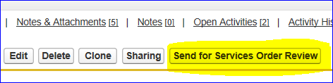
Services Order Review
Ensure terms are aligned in the SOW and opportunity
Press “Send”
Attach executed SOW
Press “Send for Services Order Review”
Attach executed SOW to opportunity

Slide 19
Services Order Review
Return to Submitter
Services Order
Missing details
Roles don’t match
Setup Project in Time Consultant
Rates don’t match
No Discount Approval
Assign Delivery Manager
Finalize Staffing
Schedule Kick-off
No signature

Slide 20
Services Opportunity Escalation
SvcsOppEscalation@Orasi.com
Jim Arnold
Jim Azar
Caleb Billingsley
Mark Lewis
Karl Rubin
Steve McGinley

Slide 21
Thank you!

